Slide 1

6th Grade Accelerated Math
Unit 10, Lesson 5 Comparing Graphical Representations Volume 2, pg. 129

Slide 2


Benchmark
MA.7.DP.1.2
Given two numerical or graphical representations of data, use the measure(s) of center and measure(s) of variability to make comparisons, interpret results, and draw conclusions about the two populations.
volume 2, pg. 129

Slide 3
Integrated Mathematical Thinking and Reasoning Standards
MA.K12.MTR.1.1 Actively participate in effortful learning both individually and collectively.
MA.K12.MTR.2.1 Demonstrate understanding by representing problems in multiple ways.
MA.K12.MTR.4.1 Engage in discussions that reflect on the mathematical thinking of self and others.
MA.K12.MTR.7.1 Apply mathematics to real-world contexts.
volume 2, pg. 129

Slide 4

Learning Target
I can use two graphical representations of data to make comparisons and draw conclusions about the populations.
volume 2, pg. 129

Slide 5

Warm-Up
volume 2, pg. 129

Slide 6
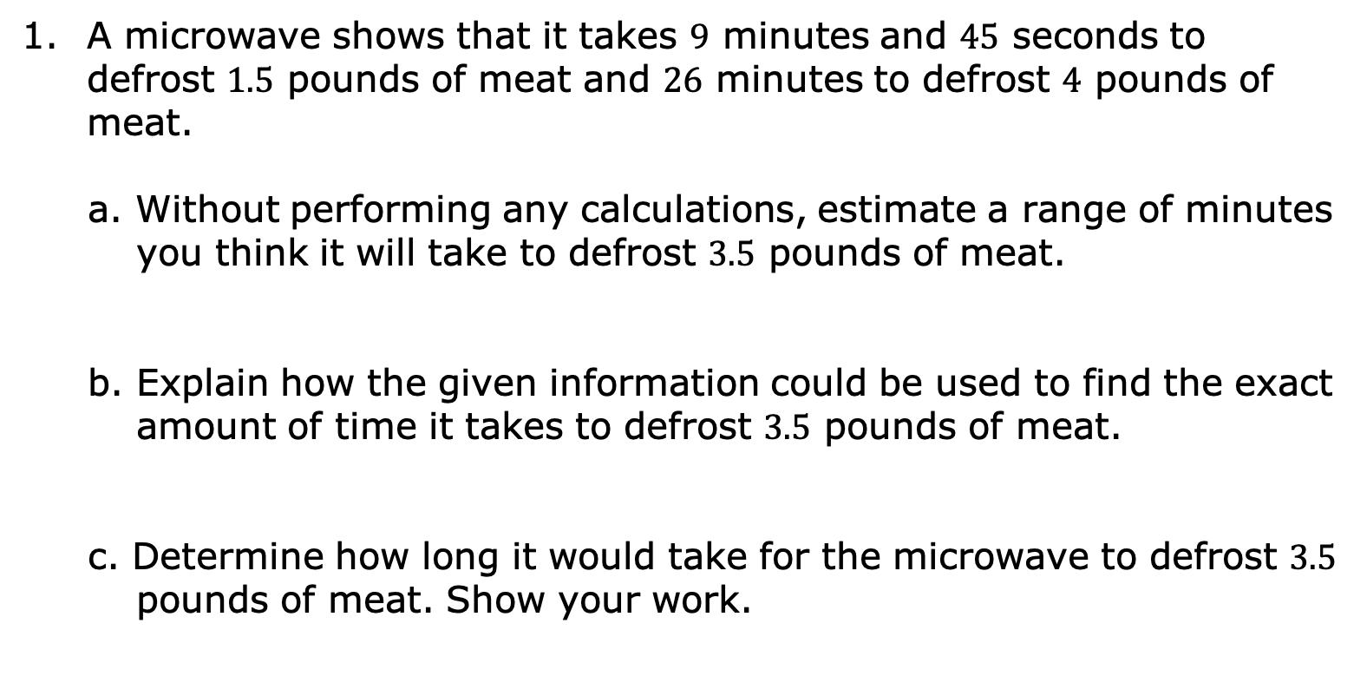
10.5.1 Warm-Up: Defrost Time
A microwave shows that it takes $9$ minutes and $45$ seconds to defrost $1.5$ pounds of meat and $26$ minutes to defrost $4$ pounds of meat.
a. Without performing any calculations, estimate a range of minutes you think it will take to defrost $3.5$ pounds of meat.
b. Explain how the given information could be used to find the exact amount of time it takes to defrost $3.5$ pounds of meat.
c. Determine how long it would take for the microwave to defrost $3.5$ pounds of meat. Show your work.
volume 2, pg. 129

Slide 7

Guided Practice
volume 2, pg. 129

Slide 8

10.5.2 Guided Practice: Comparing Line Plots
Clare recorded the amount of time a sample of students in the sixth, eighth, and tenth grades spent doing homework, in hours per week. She made a line plot of the data for each grade and provided the following summary:
Students in sixth grade tend to spend less time on homework than students in eighth and tenth grades.
The homework times for the tenth-grade students are more alike than the homework times for the eighth-grade students.
volume 2, pg. 129

Slide 9
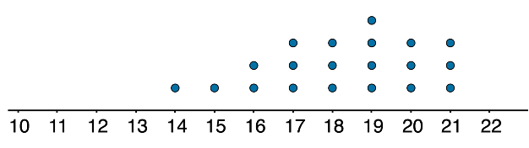
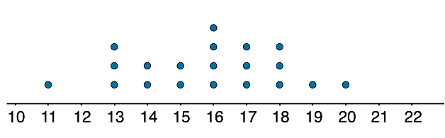
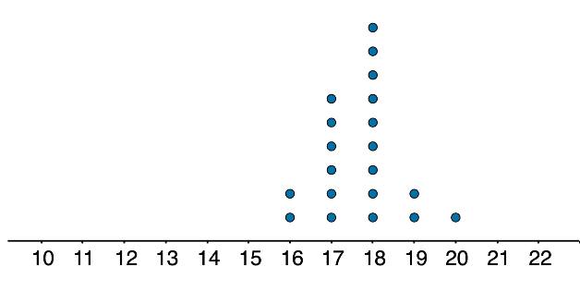
Use Clare's summary to match each line plot to the correct grade (sixth, eighth, or tenth).
Grade Level | Line Plot
_____ ________ ________
Time (in hours)
volume 2, pg. 129

Slide 10

Activity
volume 2, pg. 130

Slide 11

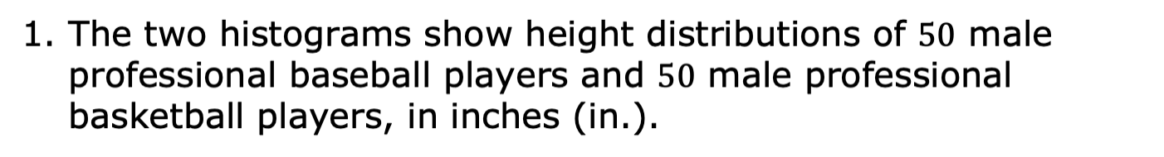
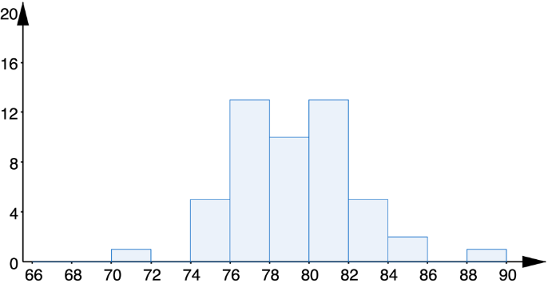
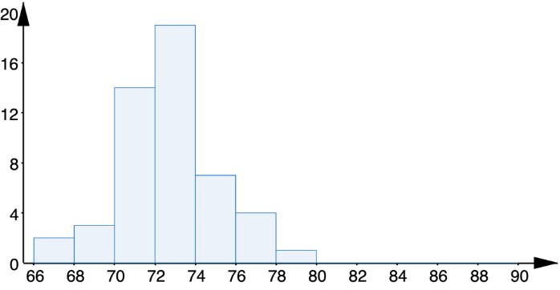
10.5.3 Activity: Station 1 – Histograms and Line Plots
Heights of Basketball Players
Heights of Baseball Players
Height (in.)
volume 2, pg. 130

Slide 12
Complete the statements that draw a conclusion about the typical height of professional basketball players and baseball players.
The sample data in the histograms shows the
center of the data for basketball players is
less than
greater than
the center of the data for baseball
players. It can be concluded that professional
shorter than
taller than
basketball players are typically
professional baseball players.
volume 2, pg. 130

Slide 13
Complete the statement.
The histograms show that in the samples, the
less than
greater than
range of heights of basketball players is
the range of the heights of baseball players. We can
conclude that professional basketball players have
more
less
variability in their heights than professional
baseball players. One possible reason for this is …
volume 2, pg. 130

Slide 14
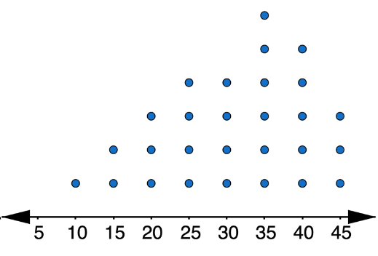
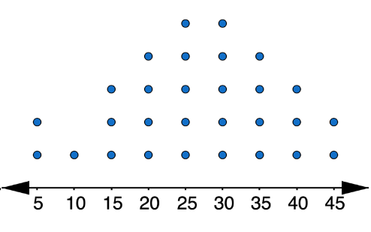
Mr. Logan surveyed a sample of his junior and senior students about the time they spend studying math per day. He then tabulated the results and created a line plot displaying the data for each group.
Time Spent Studying (Juniors)
Time Spent Studying (Seniors)
Minutes
Minutes
volume 2, pg. 131

Slide 15
The value of the larger median study time for the two groups is ______.
The value of the larger mean study time for the two groups is ______.
In one to two sentences, describe the difference between the number of minutes Mr. Logan’s juniors and seniors study by comparing the center and shapes for the groups.
volume 2, pg. 131

Slide 16
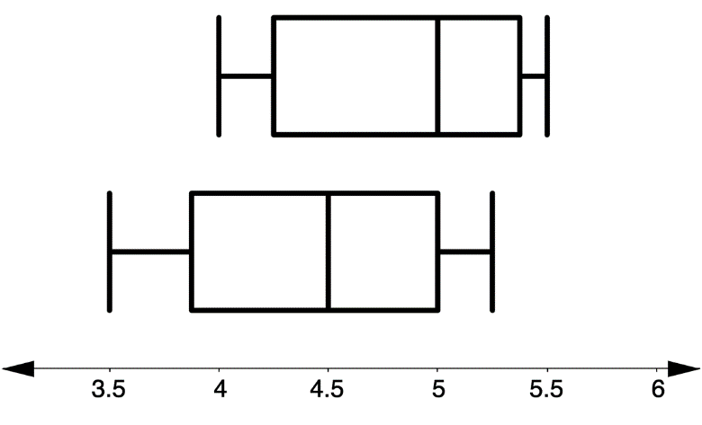
10.5.4 Activity: Station 2 – Box Plots
The mile times for a sample of track team members at East Bay High School and Leto High School are shown in the two box plots.
Using the box plots above, calculate and describe each of the features for Leto High in the table.
East Bay High
Leto High
Mile Time (minutes)
volume 2, pg. 131

Slide 17
Feature | East Bay High School | Leto High School
Shape | The shape of the data is asymmetrical.
Center | The median mile time for the sample of East Bay High team members is 5 minutes.
Variability | The range of the sample of East Bay High team members’ mile times is 1.5 minutes. The IQR of the sample of East Bay High team members’ miles times is 0.75 minutes.
volume 2, pg. 131

Slide 18
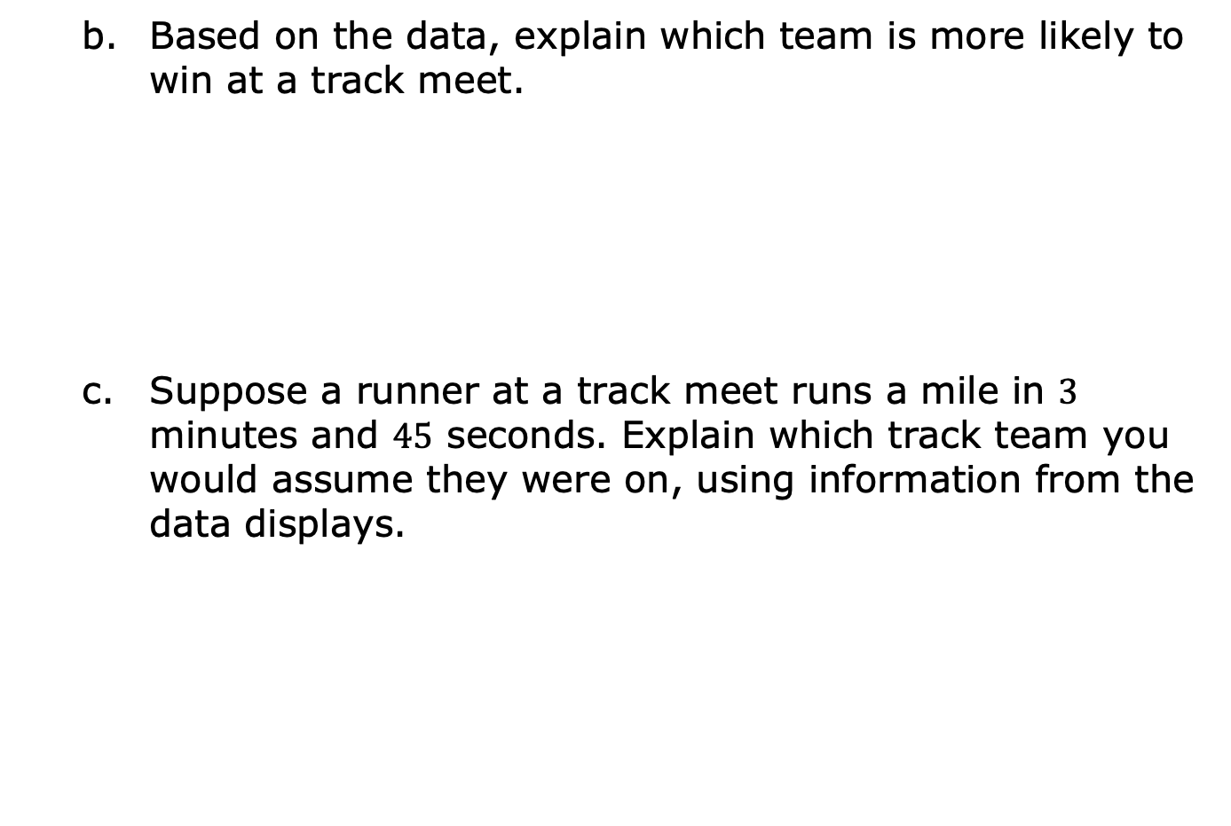
volume 2, pg. 132

Slide 19
Based on your conclusions and answers to Parts A through C, use some of the terms from the word bank below to write a 4-5 sentence summary comparing the population of runners at East Bay High School to the population of runners at Leto High School.
mean median range IQR
center variability upper quartile
lower quartile sample population
volume 2, pg. 132

Slide 20
10.5.5 Activity: Station 3 – Stem-and-Leaf Plots and Box Plots
A sample of two stores’ guitar prices are shown in the stem-and-leaf plots.
Store A’s Guitar Prices Store B’s Guitar Prices
Stem | Leaf |  | Stem | Leaf
2 | 1, 2, 8 |  | 4 | 5, 8
3 | 3,6 |  | 5 | 6, 9
4 | 5, 8, 8 |  | 6 | 1, 1, 3, 5
5 | 1, 6 |  | 7 | 5, 5, 6
6 |  |  | 8 | 0, 6
7 | 2, 2 |  | 9 | 1, 8
8 | 1, 6 |  | 10 | 0
9 | 1
Key: 2|1 = $210.00 |  |  | Key: 2|1 = $210.00
volume 2, pg. 132

Slide 21
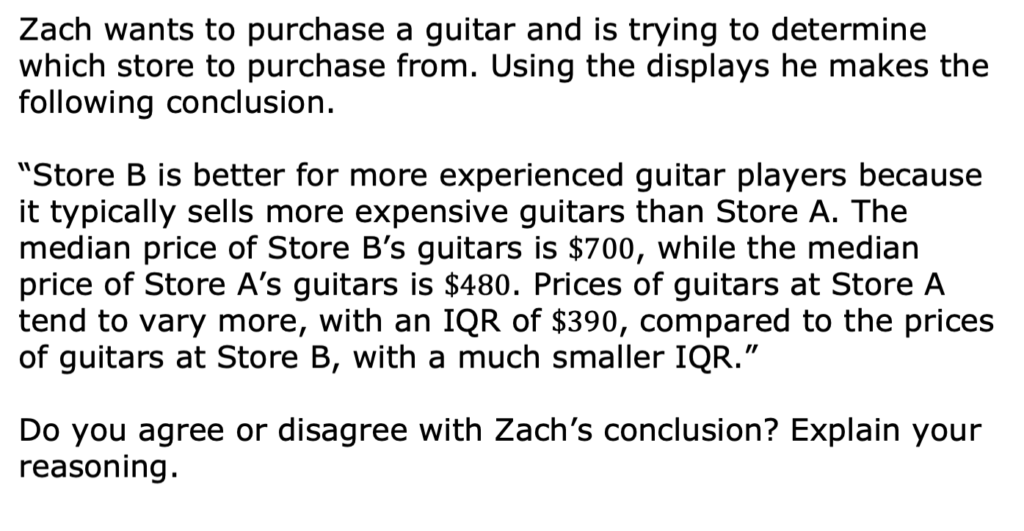
volume 2, pg. 132

Slide 22
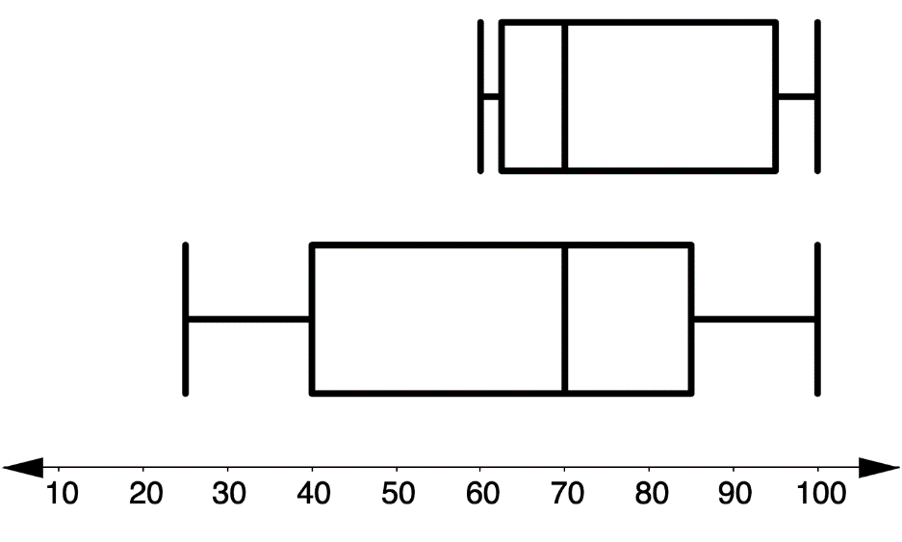
Suppose a sample of test scores is taken from Mr. Spellman’s morning math classes. The data is displayed in the top box plot. Another sample of test scores is taken from Mr. Spellman’s afternoon math classes. The data is displayed in the bottom box plot.
Morning Test Scores
Afternoon Test Scores
volume 2, pg. 133

Slide 23
Explain the difference between taking Mr. Spellman’s math test in the morning compared to the afternoon. Use some of the terms from the word bank and be sure to include both a measure of center and variability in your explanation.
mean median range IQR
center variability upper quartile
lower quartile sample population
volume 2, pg. 133

Slide 24

Wrap-Up
volume 2, pg. 133

Slide 25
10.5.6 Wrap-Up: Reflection
Complete each statement based on your current understanding.
I am still unsure about ____________________________
______________________________________________________________________________________________
One question I have that will help me better understand is _______________________________________________
_____________________________________________________________________________________________?
volume 2, pg. 133

